Slide 1
Microsoft Cognitive Services and Custom Vision
Víctor Escudero Rusillo
vescuderorusillo@gmail.com
victor.escudero@bestsecret.com

Slide 2
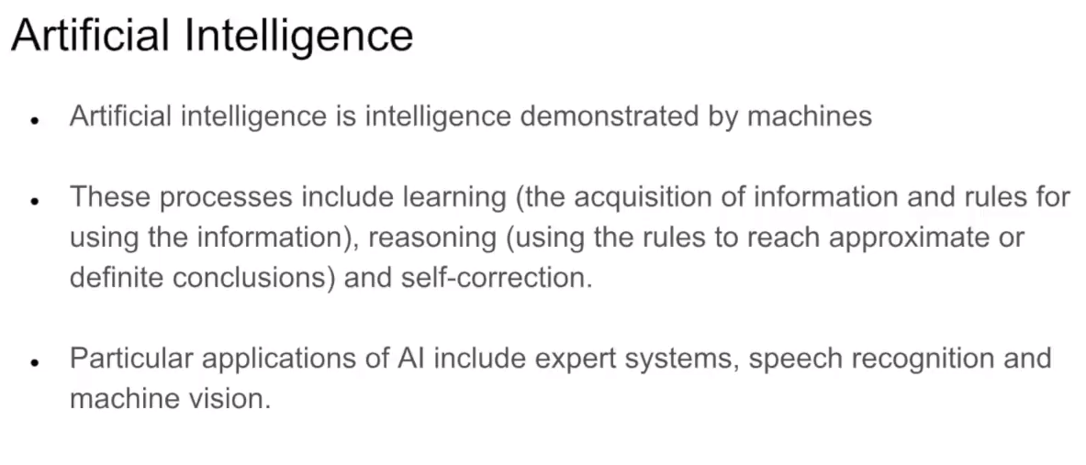
https://www.youtube.com/watch?v=dYFfNcjM4mo
Microsoft Ignite: https://www.youtube.com/watch?v=nSqEztaHpTE

Slide 3
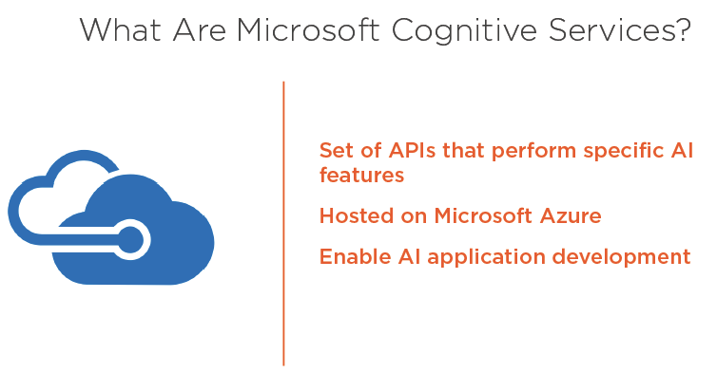
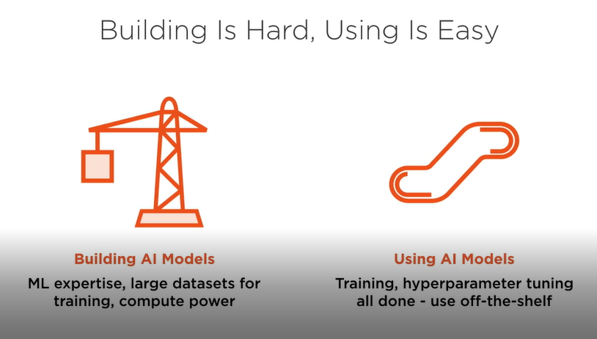

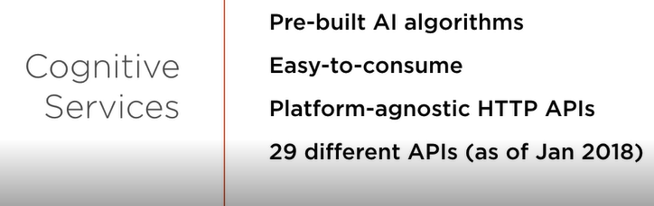

Slide 4
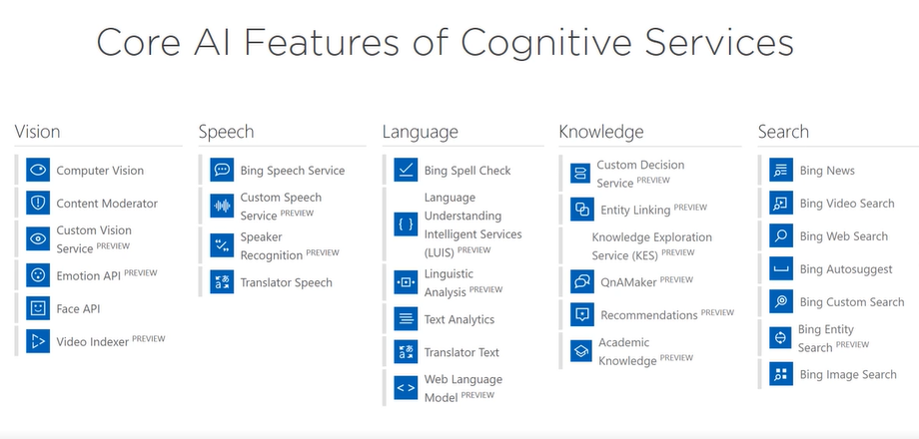
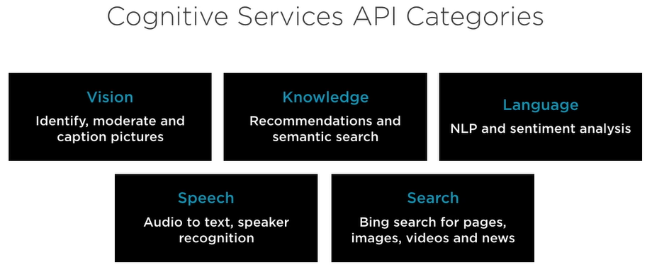

Slide 5
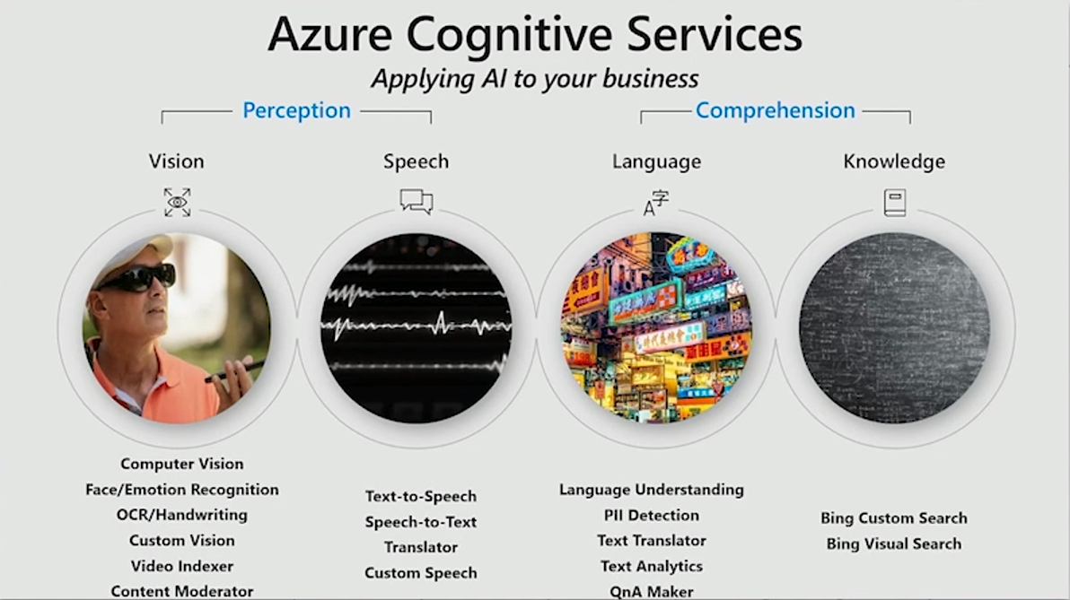
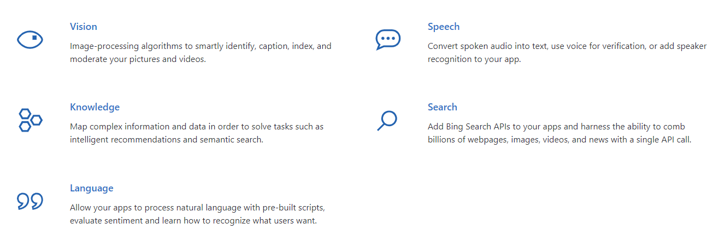
Microsoft Cognitive Services
Infuse your apps, websites and bots with intelligent algorithms to see, hear, speak, understand and interpret your user needs through natural methods of communication.

Slide 6
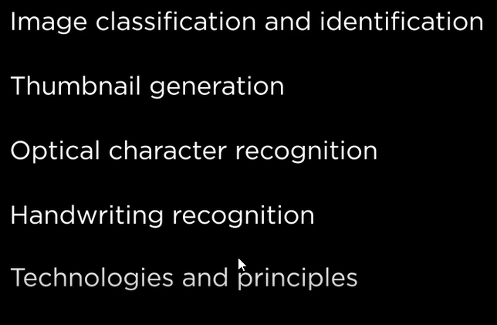
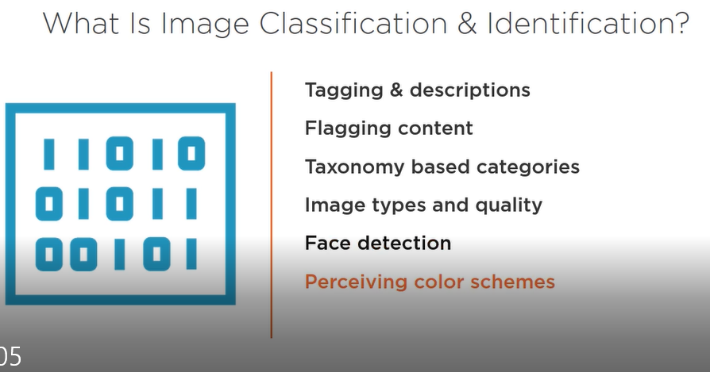
Computer Vision API

Slide 7
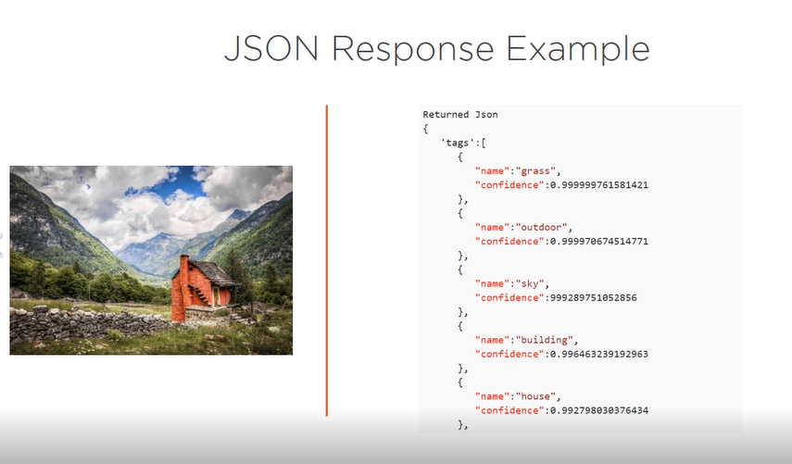

Slide 8

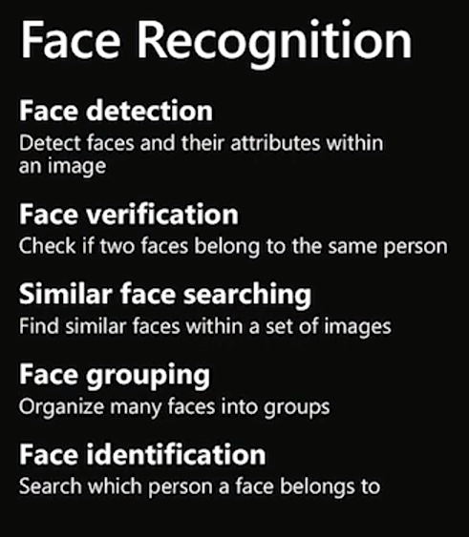
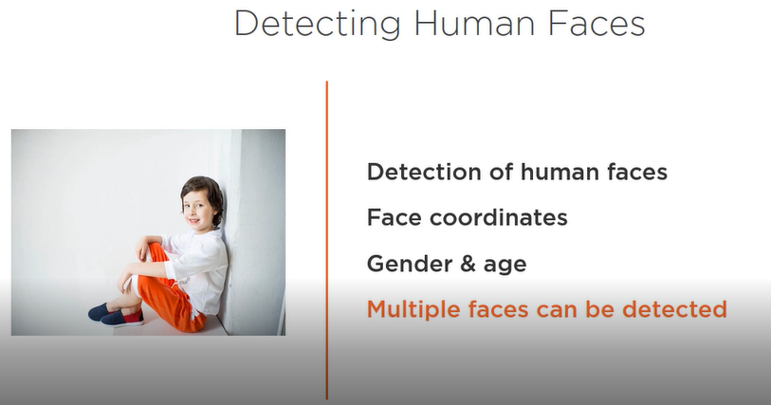
Face Api
Detect and compare human faces
Organize images into groups based on similarities
Identify previously tagged people in images
Run locally on-premises or in the cloud

Slide 9

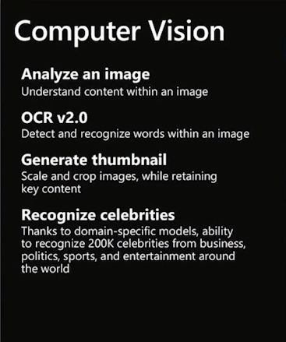
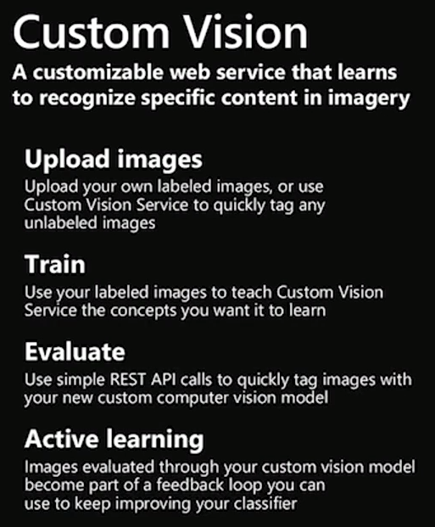
Custom Vision
Azure Custom Vision is a cognitive service that lets you build, deploy and improve your own image classifiers. An image classifier is an AI service that applies labels (which represent classes) to images, according to their visual characteristics. Unlike the Computer Vision service, Custom Vision allows you to determine the labels to apply.

